Slide 1
LESSON 3.1
VSEPR Theory

Slide 2
LESSON GOALS
I can use VSEPR theory to deduce the electron domain geometry, molecular geometry, and associated bond angles of molecules or ions with up to 6 electron domains

Slide 3
TASK 1: REVIEW (SHOULD DO)
Individually or with a partner:
If you need to review Lewis structures or formal charges, watch the appropriate videos from this YouTube Playlist

Slide 4
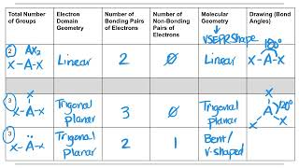
TASK 2: LEARN (MUST DO)
Individually:
Watch the VSEPR Theory Part 1 video
Complete the VSEPR Theory summary chart

Slide 5
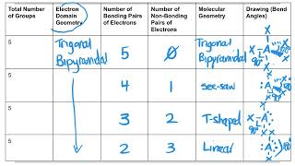
TASK 3: LEARN (MUST DO)
Individually:
Watch the VSEPR Theory Part 2 video
NOTE: There’s an error in this video - can you find it??
Complete the VSEPR Theory summary chart

Slide 6
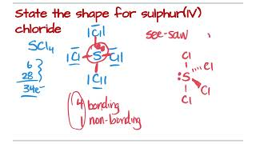
TASK 4: LEARN (MUST DO)
Individually:
Watch the VSEPR Theory Part 3 video
Take some notes for yourself!

Slide 7
TASK 5: PRACTICE
Individually or with a partner:
Complete the VSEPR practice (answers included)
Note: There are must do, should do, and aspire to do questions included in this practice!

Slide 8
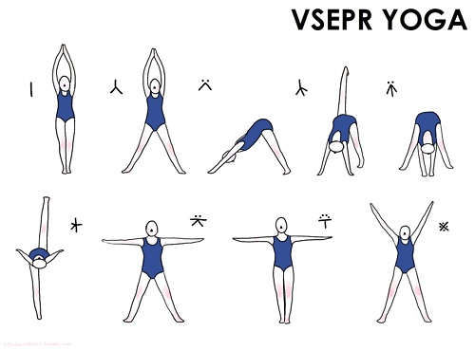
TASK 6: PRACTICE (ASPIRE TO DO)
Practice some VSEPR Yoga!

Slide 9
TASK 7: MASTERY CHECK (MUST DO)
Individually:
Complete the VSEPR Theory mastery check (see me when you are ready!)

